Slide 1







SDAIA ACADEMY
Top 10000 Popular Movies
presentation
presentation
Shaima alzahrani
T5 data science bootcamp

Slide 2

Contents
Introduction
2. Design
3. Analysis and results.
4. Conclusion

Slide 3

Introduction
Recommendation systems are used everywhere these days. Netflix , Amazon Prime , YouTube , Online shopping sites etc.
This project aimed to provides suggestions by movies Recommendation system. To help people find the most popular movies according to people's ratings. by implement an exploratory data analysis on the dataset for 10000 Popular movies based on the TMDB ratings.

Slide 4


Design

Slide 5

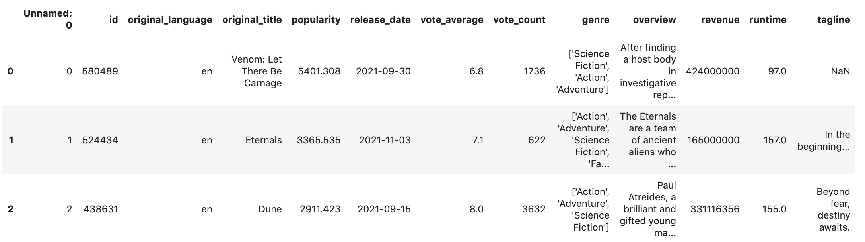
Rows & columns
This data provided by Kaggle
contains 10,000 movies divided into 13 columns:

Slide 6

Challenges
1. Remove missing values
3. Covert type of columns
2. Split column that have multiple values

Slide 7
Analysis And Results

Slide 8
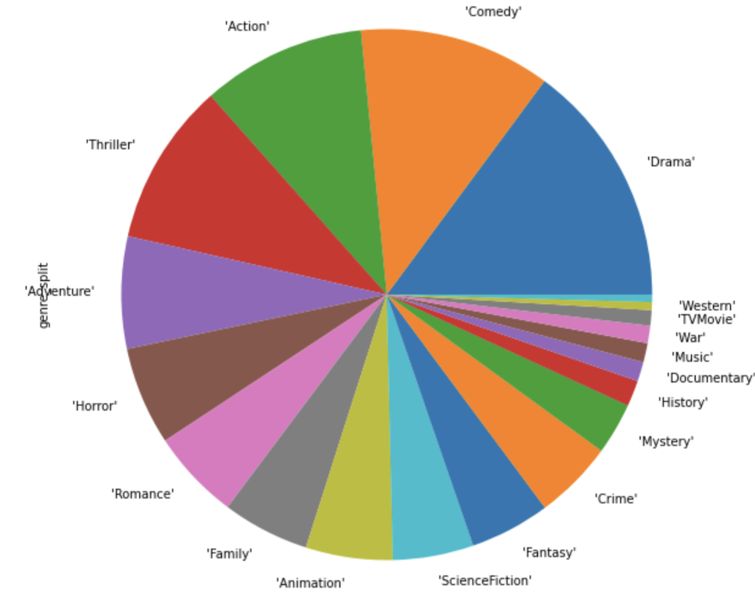
Which type of movies are more popular?

Slide 9
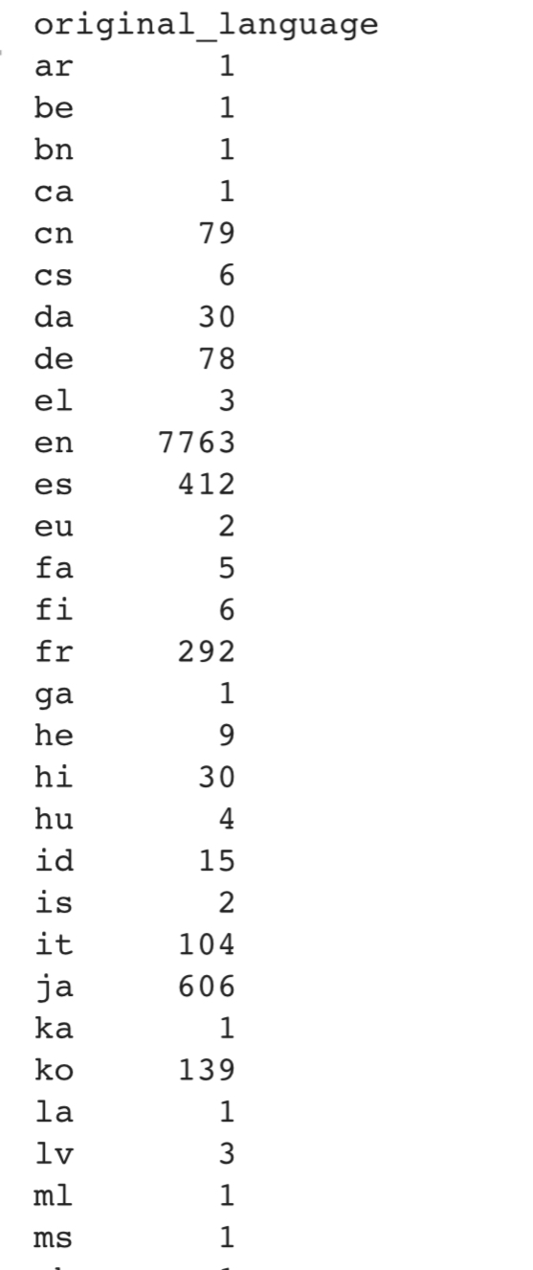
What are the most popular language in movies?
English is the most popular language

Slide 10
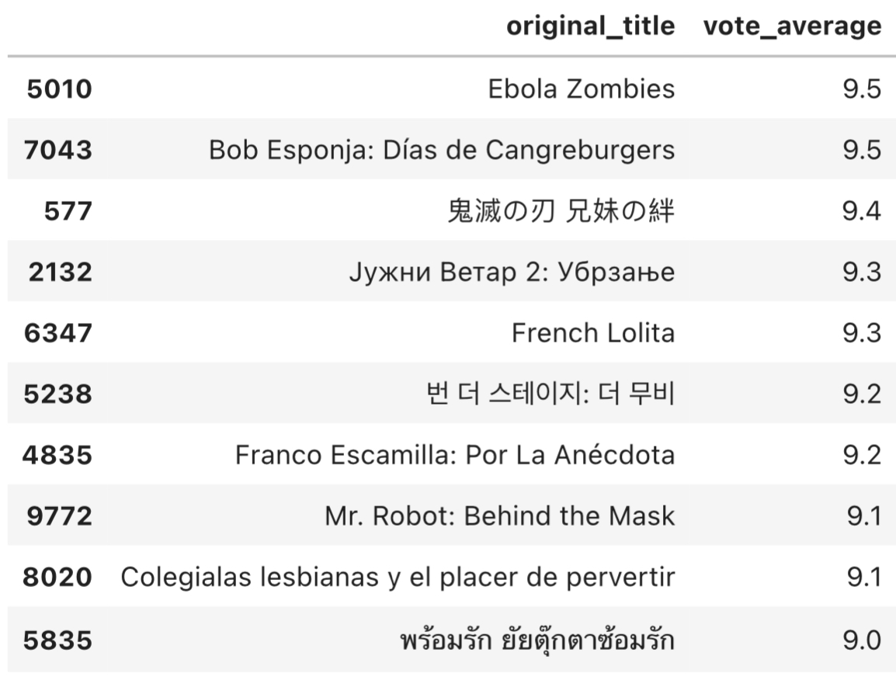
What the top 10 movies with maximum vote average?

Slide 11
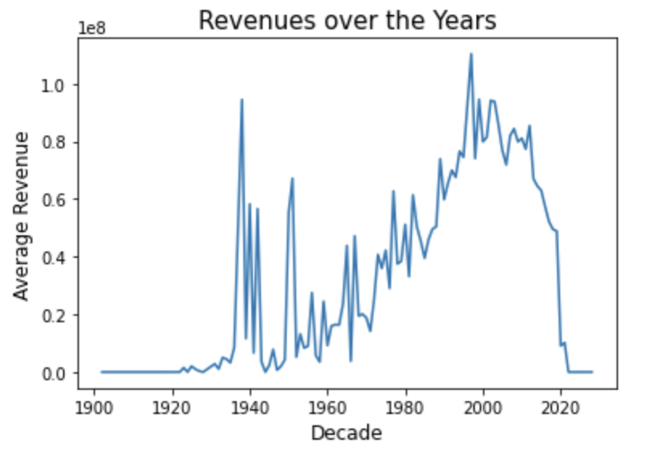
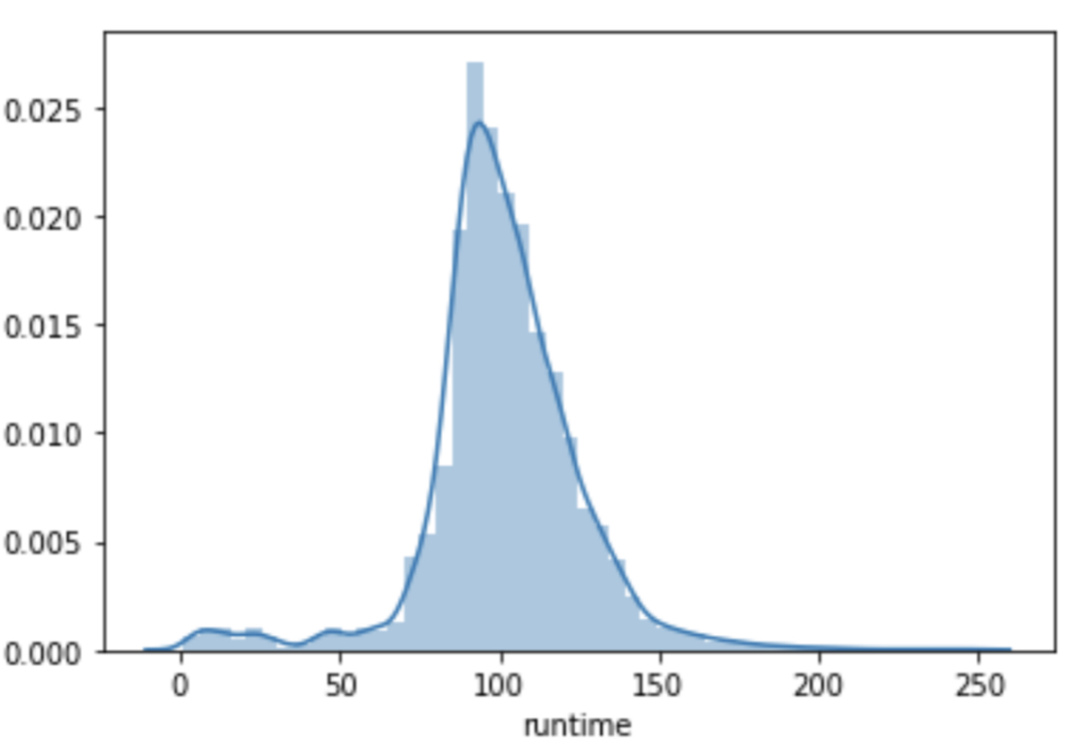
Analysis of the revenue trend over the decades?
Analysis of the trend of movie’s runtime?

Slide 12
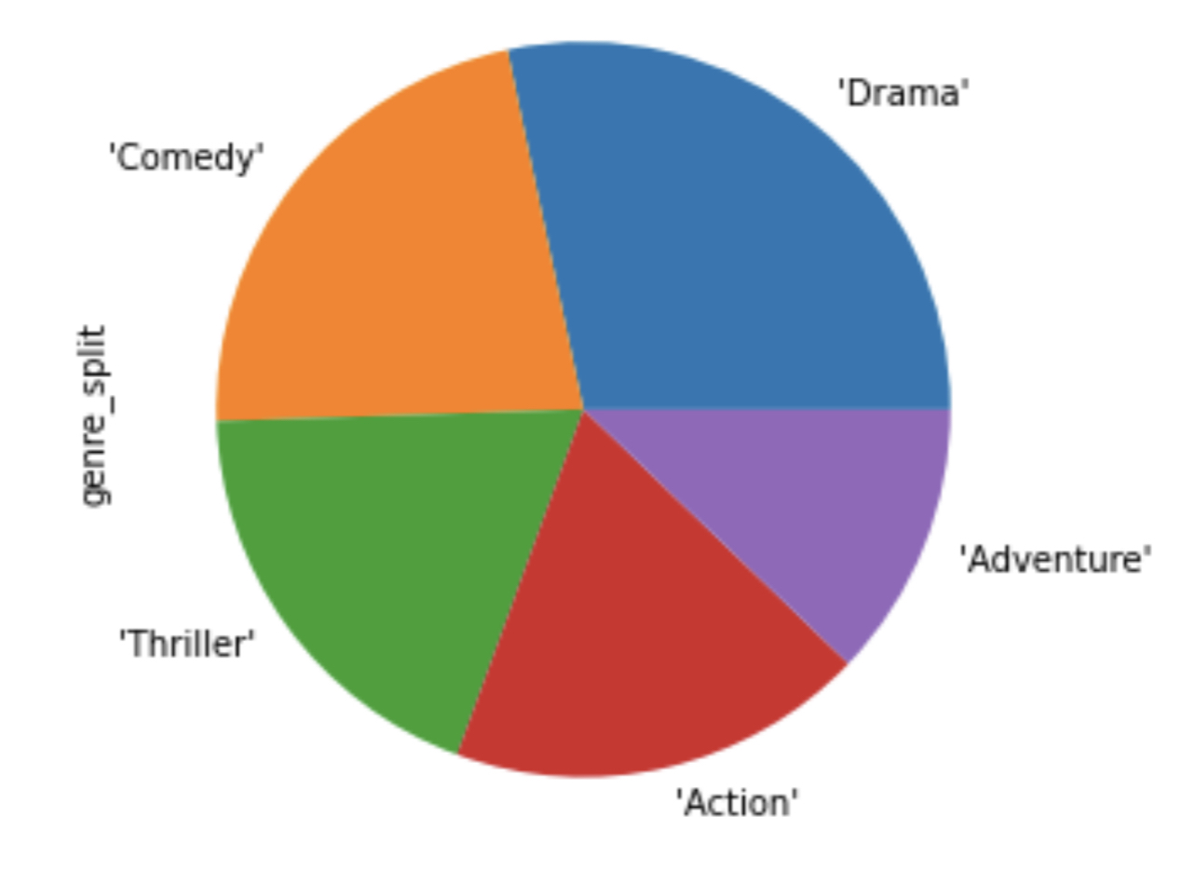
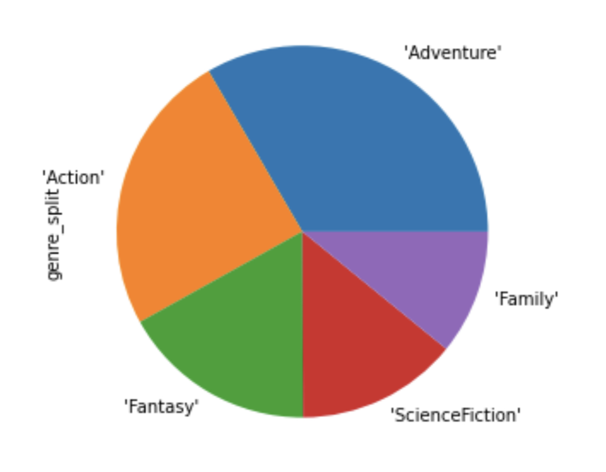
Are specific genres associated with higher revenues?
Movies that make less revenue are Dramas, Comedies, and Thrillers.
The top 100 revenue producing movies are Adventure, Action, and Fantasy.

Slide 13

Conclusion
Drama, Comedy, Thriller, and Action are the most popular genres in general
English is the most popular language,
Revenues from 1960-2015 have increased
Most movies has an runtime between 90 mins to 120 mins
The top 100 revenue producing movies are Adventure, Action, and Fantasy
The top 10 10000 Popular movies based on the TMDB ratings, The value of 'popularity' and 'votes' is subjective and dependent on those users voting and navigating through the website.and ​other sources may yield different results.

Slide 14
Thank you
Shaima Alzahrani

